Slide 1
Predictive Modeling of MIMIC III Admissions and Intensive Care Unit Length of Stays
Hero Ozagho
May 03rd,2021

Slide 2
Abstract
Objectives
The primary goal of this project is to build a design model capable of predicting patients’ LOS in the ICU, having as main predictor variables those commonly used in clinical practice for the assessment of the state of the patient. Emphasis has been placed to the first value recorded for each variable selected and time evolution is not contemplated. The selected variable indicators must be obtained during the first 24 hours of stay in ICU.
Design
The design of the model starts with raw data collection, data preparation, data cleaning and exploratory data analysis. Two design models were utilized separately for predictive performance from the MIMIC III database.
Measurement
The data set for icustay only contains 100 patients but there are 136 entries in icustay table, which means that some patients have multiple icustay. During the first icustay, 37 patients did not survive, and the number for the last ICU stay is 36. The last icustay table was utilized as the data frame to do exploratory data analysis and build a prediction model. There are also a total of 758,355 chart events and 76,074 lab events during the 136 entries in icustay table.
Results
The Binomial regression model has an AUC of 84% in training data, which is surprisingly good, while the AUC in testing data was approximately 56%. The Random Forest model predictive performance was better than the Binomial model.
Conclusion
There are 9 variables from 758,355 chart events and 76,076 lab events that are identified and thus successfully built a Random Forest to predict patients that survives during icustay with an approximately 36% Out-Of-Bag error rate.

Slide 3
Measurements – ICUSTAYS & Chartevents
> last_ICU_stay <- icustays %>%
+ left_join(admissions, by = c("subject_id" = "subject_id", "hadm_id" = "hadm_id")) %>%
+ group_by(subject_id) %>%
+ filter(intime == max(intime)) %>%
+ ungroup() %>%
+ select(subject_id, hadm_id, icustay_id, intime,los, diagnosis, hospital_expire_flag)
> t1 <- first_ICU_stay %>% filter(hospital_expire_flag == 1) %>% count()
> t2 <- last_ICU_stay %>% filter(hospital_expire_flag == 1) %>% count()
> kable(list(t1, t2)) %>% kable_styling()
> str(chartevents)
'data.frame': 758355 obs. of 15 variables:
$ row_id : int 5279021 5279022 5279023 5279024 5279025 5279026 5279027 5279028 5279029 5279030 ...
$ subject_id : int 40124 40124 40124 40124 40124 40124 40124 40124 40124 40124 ...
$ hadm_id : int 126179 126179 126179 126179 126179 126179 126179 126179 126179 126179 ...
$ icustay_id : int 279554 279554 279554 279554 279554 279554 279554 279554 279554 279554 ...
$ itemid : int 223761 224695 220210 220045 220179 220180 220181 220046 220047 223751 ...
$ charttime : chr "2/4/2130 4:00" "2/4/2130 4:25" "2/4/2130 4:30" "2/4/2130 4:32" ...
$ storetime : chr "2/4/2130 4:35" "2/4/2130 5:55" "2/4/2130 4:43" "2/4/2130 4:43" ...
$ cgid : int 19085 18999 21452 21452 21452 21452 21452 19085 19085 19085 ...
$ value : chr "95.9" "2222221.7" "15" "94" ...
$ valuenum : num 9.59e+01 2.22e+06 1.50e+01 9.40e+01 1.63e+02 ...
$ valueuom : chr "?F" "cmH2O" "insp/min" "bpm" ...
$ warning : int 0 0 0 0 0 0 0 0 0 0 ...
$ error : int 0 0 0 0 0 0 0 0 0 0 ...
$ resultstatus: chr "" "" "" "" ...
$ stopped : chr "" "" "" "" ...

Slide 4
Diagnosis
> last_ICU_stay <- last_ICU_stay %>% mutate(diagnosis_type = case_when(
+ grepl("(.)*CANCER|(.) CA|(.)*LEUKEMIA", diagnosis, ignore.case = TRUE) ~ "CANCER",
+ grepl("(.)*SEPSIS|INFECTION|CHOLANGITIS|ABSCESS|FEVER|PNEUMONIA", diagnosis, ignore.case = TRUE) ~ "INFECTION",
+ grepl("(.)*MI|VF ARREST|STROKE(.)*|CHEST PAIN|MYOCARDIAL", diagnosis, ignore.case = TRUE) ~ "ACUTE CARDIAC",
+ grepl("(.)*ACCIDENT|FRACTURE|(.)*FALL|SEIZURE|BREATH|BLEED|HEMATOMA|OVERDOSE|SYNCOPE(.)*|TACHYPNEA|ACUTE",diagnosis, ignore.case = TRUE) ~ "ACUTE",
+ grepl("(.)*PULMONARY|RESPIRATORY|LUNG|ASTHMA|LIVER|HEPATI(TIS|IC)|ESOPHAGEAL|OA|ARTHRITIS|(HYPO|HYPER)TENSION|HEADACHE|DISTRESS|MENTAL|HEAD|ANGINA|BRAIN|HEART FAILURE|(.)*EFFUSION|FAILURE TO THRIVE|"
+ , diagnosis, ignore.case = TRUE) ~ "CHRONIC", TRUE ~ "OTHERS"))
> ggplot(last_ICU_stay, aes(x=diagnosis_type, fill = factor(hospital_expire_flag)))+
+ geom_bar(stat = "count", position = "dodge")+
+ theme_bw()+
+ theme(axis.text.x = element_text(size = 8, angle = 90))+
+ labs(x= "Diagnosis Type", y="Case Counts", title = "Diagnosis Type Case Counts")+
+ scale_y_continuous(breaks = c(0,1,2,3,4,5,8,12))+
+ scale_fill_discrete(name="Death", labels=c("0 (n=85)","1 (n=100)"))
> mosaicplot(table(last_ICU_stay$diagnosis_type, last_ICU_stay$hospital_expire_flag),
+ main = "Diagnosis Type by Death 1", shade = TRUE, las = 2)

Slide 5
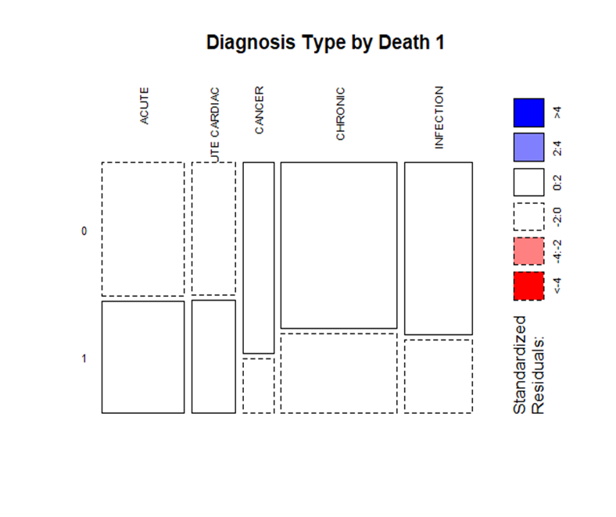
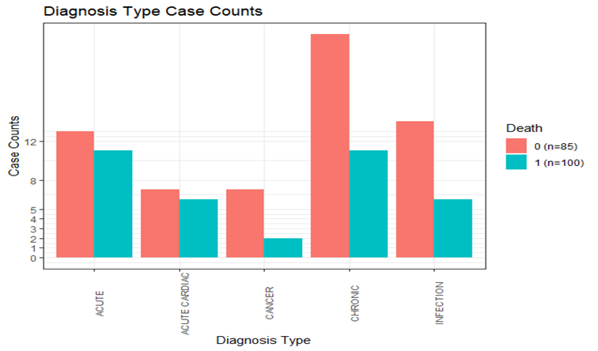
Diagnosis analysis
Diagnosis Type Case counts
Diagnosis Type by Death 1

Slide 6
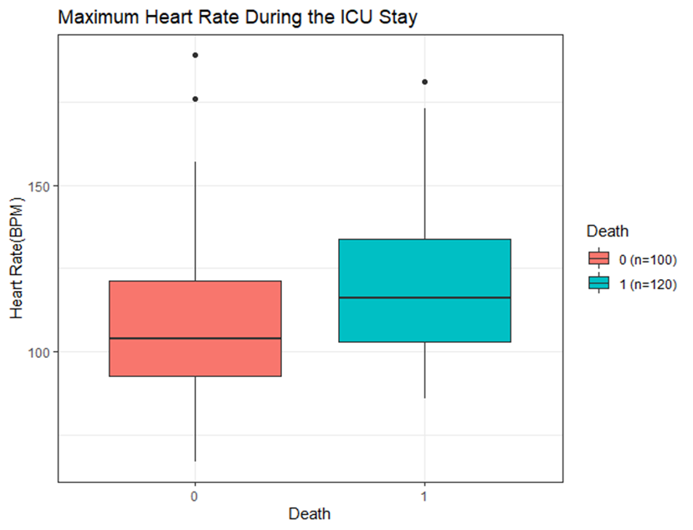
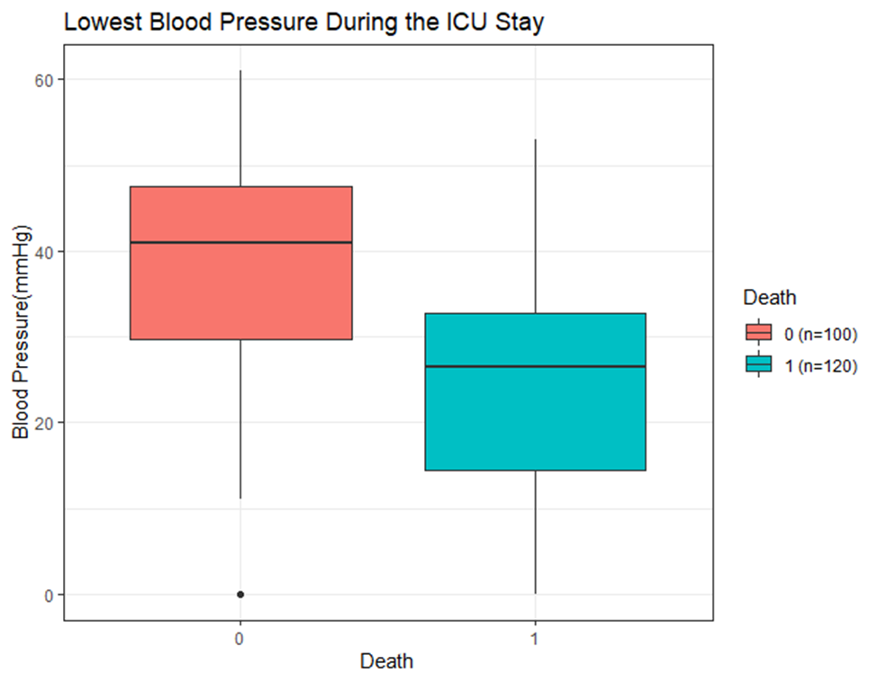
Heart Rate and Blood Pressure
Max. Heart Rate (ICUSTAY)
Low. Blood Pressure (ICUSTAY)

Slide 7
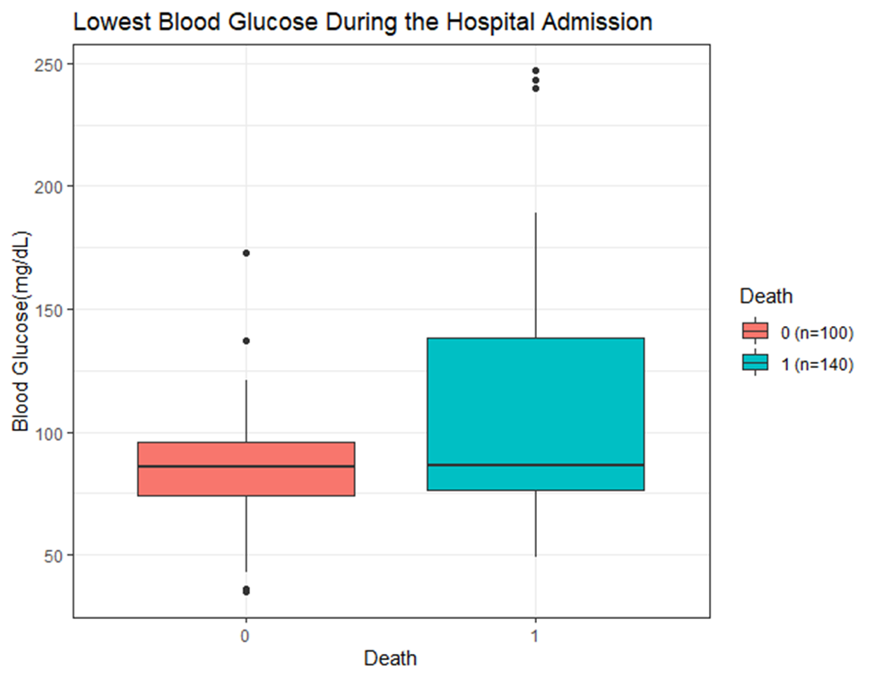
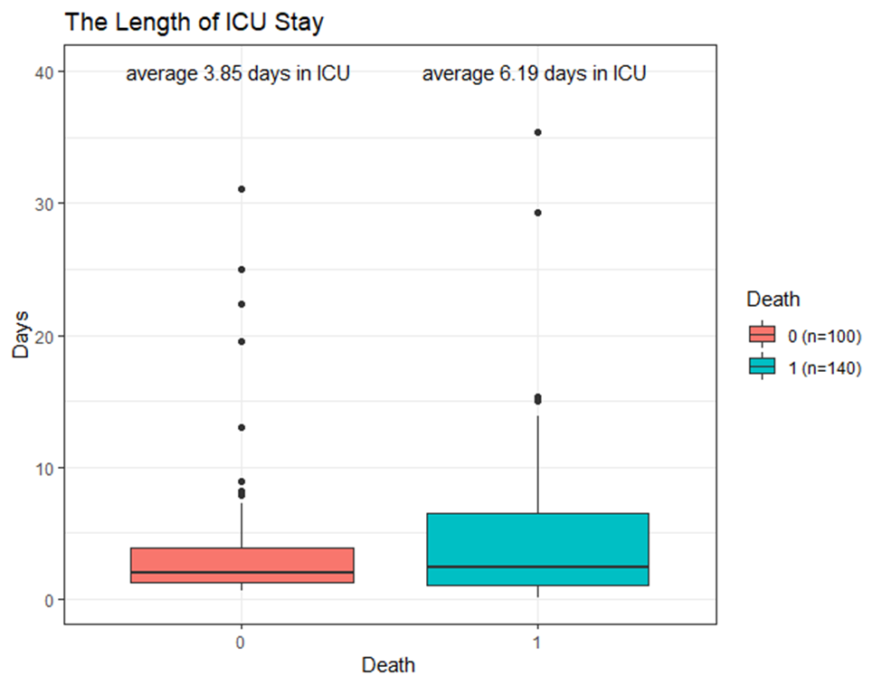
Blood Glucose and Length of ICUSTAY
Low. Blood Glucose
Length of ICUSTAY

Slide 8
Age and Gender
select(subject_id, dob) %>%
+ right_join(last_ICU_stay) %>%
+ mutate(
+ dob = mdy_hm(dob),
+ intime = mdy_hm(intime),
+ age_intake_ICU = round(as.numeric(intime - dob)/365.25)
+ )%>% View()
Joining, by = "subject_id"
Warning in View :
8 failed to parse.
> #Age
> date_of_birth <- patients %>%
+ select(subject_id, dob) %>%
+ right_join(last_ICU_stay) %>%
+ mutate(
+ dob = mdy_hm(dob),
+ intime = mdy_hm(intime),
+ age_intake_ICU = round(as.numeric(intime - dob)/365.25)
+ )%>%
+ select(subject_id, hadm_id, icustay_id, age_intake_ICU, hospital_expire_flag)
Joining, by = "subject_id"
Warning message:
Problem with `mutate()` input `dob`.
i 8 failed to parse.
i Input `dob` is `mdy_hm(dob)`.
> table(is.na(date_of_birth$age_intake_ICU))
FALSE TRUE
92 8

Slide 9
Age and Gender
> mice_mod <- mice(last_ICU_stay[, !names(last_ICU_stay) %in% c('subject_id',
+ 'hadm_id', 'icustay_id', 'intime', 'hospital_expire_flag')], method='rf')
iter imp variable
1 1 max_heart_rate min_blood_pressure age_intake_ICU
1 2 max_heart_rate min_blood_pressure age_intake_ICU
1 3 max_heart_rate min_blood_pressure age_intake_ICU
1 4 max_heart_rate min_blood_pressure age_intake_ICU
1 5 max_heart_rate min_blood_pressure age_intake_ICU
2 1 max_heart_rate min_blood_pressure age_intake_ICU
2 2 max_heart_rate min_blood_pressure age_intake_ICU
2 3 max_heart_rate min_blood_pressure age_intake_ICU
2 4 max_heart_rate min_blood_pressure age_intake_ICU
2 5 max_heart_rate min_blood_pressure age_intake_ICU
3 1 max_heart_rate min_blood_pressure age_intake_ICU
3 2 max_heart_rate min_blood_pressure age_intake_ICU
3 3 max_heart_rate min_blood_pressure age_intake_ICU
3 4 max_heart_rate min_blood_pressure age_intake_ICU
3 5 max_heart_rate min_blood_pressure age_intake_ICU
4 1 max_heart_rate min_blood_pressure age_intake_ICU
4 2 max_heart_rate min_blood_pressure age_intake_ICU
4 3 max_heart_rate min_blood_pressure age_intake_ICU
4 4 max_heart_rate min_blood_pressure age_intake_ICU
4 5 max_heart_rate min_blood_pressure age_intake_ICU
5 1 max_heart_rate min_blood_pressure age_intake_ICU
5 2 max_heart_rate min_blood_pressure age_intake_ICU
5 3 max_heart_rate min_blood_pressure age_intake_ICU
5 4 max_heart_rate min_blood_pressure age_intake_ICU
5 5 max_heart_rate min_blood_pressure age_intake_ICU
Warning message:
Number of logged events: 92
> par(mfrow=c(1,2))
> hist(last_ICU_stay$age_intake_ICU, freq = F, main = "Age: Original Data",
+ col = 'darkgreen', ylim = c(0, 0.04))
> hist(mice_output$age_intake_ICU, freq = F, main = "Age: MICE Output",
+ col = 'lightgreen', ylim = c(0, 0.04))

Slide 10
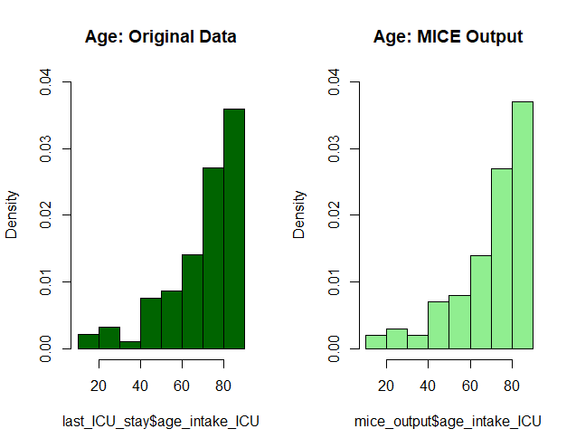
Binomial Regression Model

Slide 11
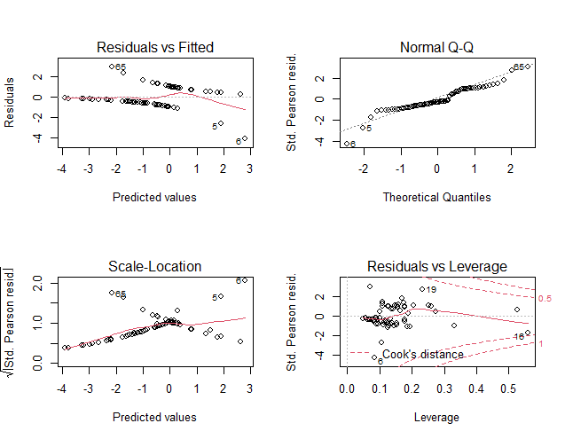
Binomial Regression Model Plots

Slide 12
Binomial Regression Model
model_bin <- training_data %>%
+ glm(formula = hospital_expire_flag ~ los+diagnosis_type
+ +max_heart_rate+min_blood_pressure+male+age_intake_ICU,
+ family = 'binomial',na.action = na.omit)
> summary(model_bin)
Call:
glm(formula = hospital_expire_flag ~ los + diagnosis_type + max_heart_rate +
min_blood_pressure + male + age_intake_ICU, family = "binomial",
data = ., na.action = na.omit)
Deviance Residuals:
Min 1Q Median 3Q Max
-2.3928 -0.8309 -0.4283 1.0465 2.1282
Coefficients:
Estimate Std. Error z value Pr(>|z|)
(Intercept) -3.45443 3.39163 -1.019 0.3084
los 0.03528 0.06395 0.552 0.5812
diagnosis_typeACUTE CARDIAC -0.48649 0.92732 -0.525 0.5998
diagnosis_typeCANCER -3.17787 1.53799 -2.066 0.0388 *
diagnosis_typeCHRONIC -1.39977 0.82103 -1.705 0.0882 .
diagnosis_typeINFECTION -1.81710 0.94747 -1.918 0.0551 .
max_heart_rate 0.02357 0.01804 1.306 0.1915
min_blood_pressure -0.04106 0.02459 -1.670 0.0949 .
male 0.46198 0.66267 0.697 0.4857
age_intake_ICU 0.03278 0.02472 1.326 0.1847
---
Signif. codes: 0 ‘***’ 0.001 ‘**’ 0.01 ‘*’ 0.05 ‘.’ 0.1 ‘ ’ 1
(Dispersion parameter for binomial family taken to be 1)
Null deviance: 91.422 on 68 degrees of freedom
Residual deviance: 71.381 on 59 degrees of freedom
AIC: 91.381
Number of Fisher Scoring iterations: 5

Slide 13
Binomial Regression Model
Training Data
Testing Data
> training_data$predicted_outcome <- predict(model_bin, training_data,
+ type = "response")
> training_roc <- training_data %>%
+ ggplot(aes(m= predicted_outcome, d=hospital_expire_flag))+
+ labs(title = "ROC Plot for Training Data")+
+ geom_roc(n.cuts = 10, labels = F, labelround = 4)+
+ style_roc(theme = theme_grey)
> calc_auc(training_roc)$AUC*100
[1] 84.07871
> testing_data$predicted_outcome <- predict(model_bin, testing_data,
+ type = "response")
> testing_roc <- testing_data %>%
+ ggplot(aes(m= predicted_outcome, d= hospital_expire_flag))+
+ labs(title = "ROC Plot for Testing Data")+
+ geom_roc(n.cuts = 10, labels = F, labelround = 4) +
+ style_roc(theme = theme_grey)
> calc_auc(testing_roc)$AUC*100
[1] 55.95238

Slide 14
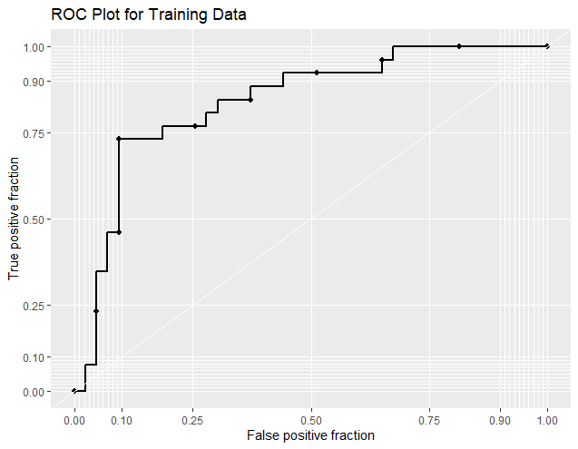
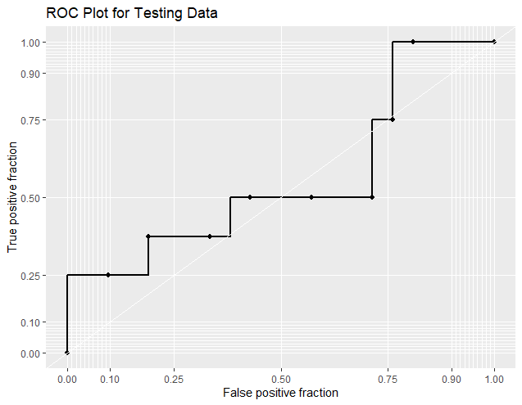
Binomial Regression Model
ROC Plot for Training Data
ROC Plot for Testing Data

Slide 15
Random Forest Model
> model_rf <- randomForest(factor(hospital_expire_flag) ~ los+diagnosis_type
+ +max_heart_rate
+ +min_blood_pressure+male+age_intake_ICU,
+ data = analysis_data, na.action = na.exclude)
> print(model_rf)
Call:
randomForest(formula = factor(hospital_expire_flag) ~ los + diagnosis_type + max_heart_rate + min_blood_pressure + male + age_intake_ICU, data = analysis_data, na.action = na.exclude)
Type of random forest: classification
Number of trees: 500
No. of variables tried at each split: 2
OOB estimate of error rate: 35.71%
Confusion matrix:
0 1 class.error
0 51 13 0.2031250
1 22 12 0.6470588

Slide 16
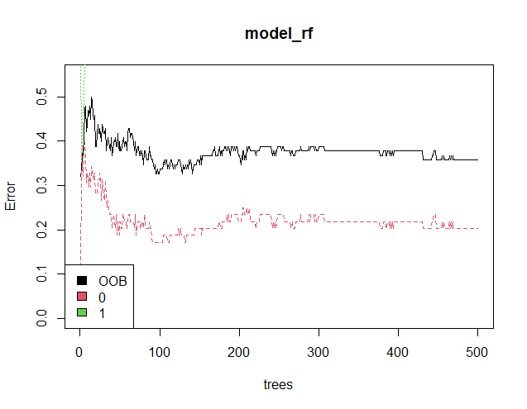
Random Forest Model

Slide 17
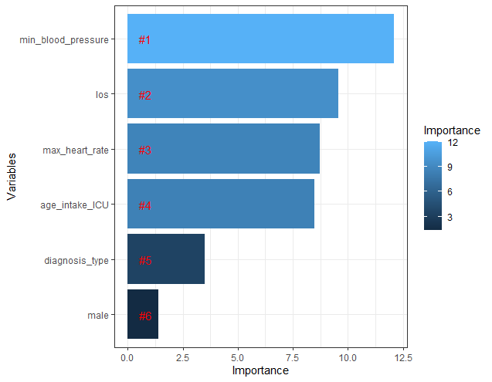
Random Forest Model

Slide 18
Random Forest Model Results
The black plot reveals the overall out-of-bag error rate which falls approximately 36%. The red and green plots show the error rate for patients that survived and died, respectively. This implies that one can easily predict survival rate than the death rate.
The minimum blood pressure and los are the top highest relative importance out of all the predictor variables. Meanwhile, the gender (male) is the least relevant variable and thus regarded as an unimportant (insignificant) variable.

Slide 19
Predictive Models Conclusions
The predictive models revealed that the model with the best results is the Random Forest Classifier which obtain the best predictions in the complete dataset and in the different groups.
It should be noted that variables with analytic outcomes are more significant in terms of the dataset and different group as related to los.
Finally, the ICU admissions and the predictive model can provide an insightful and valuable estimates to los categorically in as much as a cutoff benchmark is defined. This approach can help Doctors to simply the problems even though the dataset is complex.

Slide 20
References
E. de Jonge and M. van der Loo. An introduction to data cleaning with R. Statistics Netherlands, Discussion Paper, 2013, pp. 7
T. Dasu and T. Johnson. Exploratory Data Mining and Data Cleaning. John Wiley & Sons, Inc., 2003, pp. 99–137.
Johnson, A. E. W., Pollard, T. J., Shen, L., Lehman, L. H., Feng, M., Ghassemi, M., Moody, B., Szolovits, P., Celi, L. A., & Mark, R. G. (2016). MIMIC-III, a freely accessible critical care database. Scientific data, 3, 160035.
https://physionet.org/content/mimiciii-demo/1.4/

Slide 21
Thank you!

